Slide 1
Matrix Multiplication on ZCU111
Samarth Sharma

Slide 2
8x8

Slide 3
RMSE on Vitis
Unoptimized 1e-6
Optimized 1e-6

Slide 4
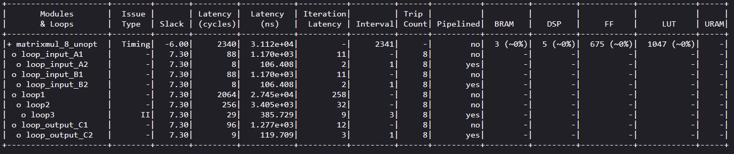
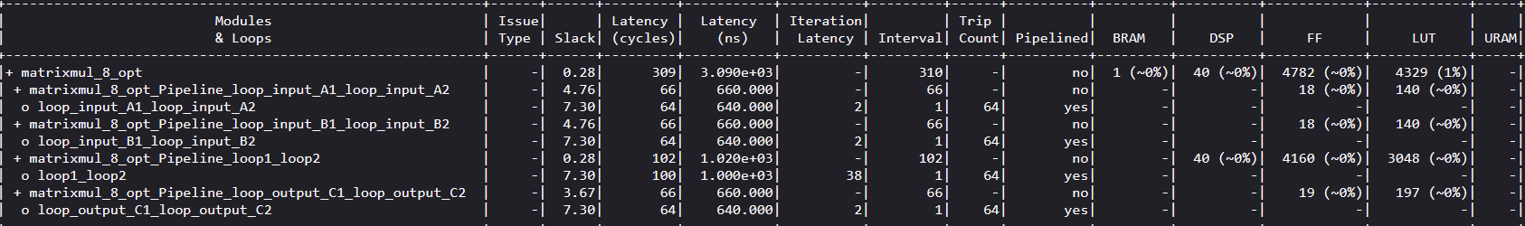
Latency & Resources in Vitis Synthesis Report
Unoptimized
Optimized

Slide 5
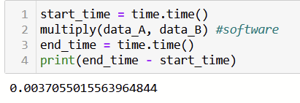
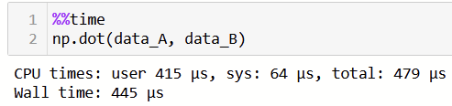
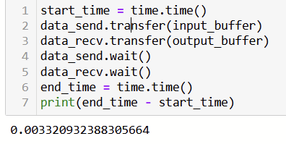
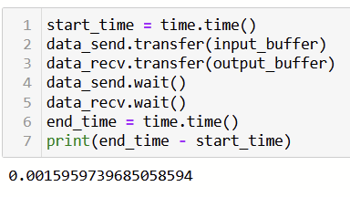
Acceleration on board
Numpy time
PS time with for loops
Unoptimized PL time
Optimized PL time
Acceleration factor(Unopt) = 1.11
Acceleration factor(Opt) = 2.33

Slide 6


RMSE on board
Unoptimized
Optimized

Slide 7
32x32

Slide 8
RMSE on Vitis
Unoptimized 6e-6
Optimized 6e-6

Slide 9
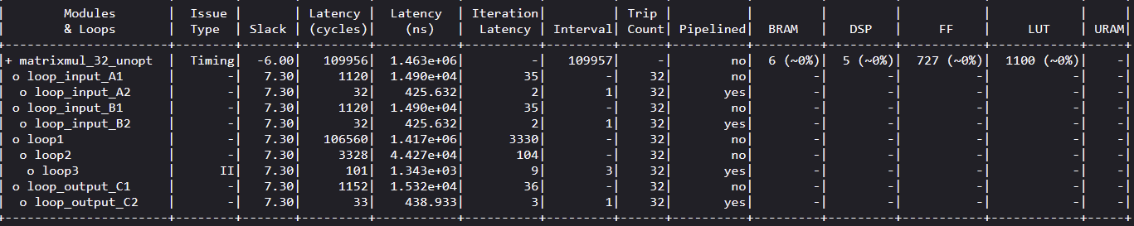
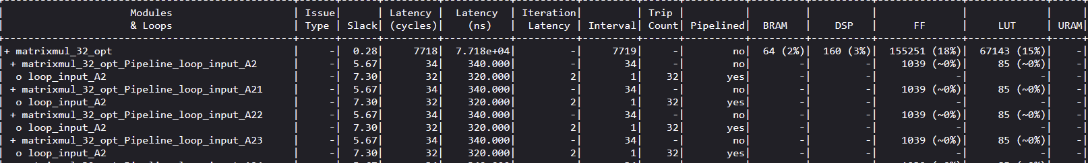
Latency & Resources in Vitis Synthesis Report
Unoptimized
Optimized

Slide 10
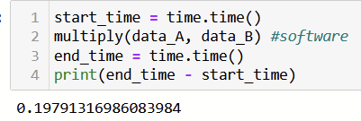
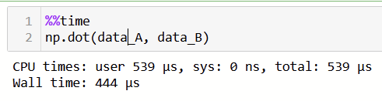
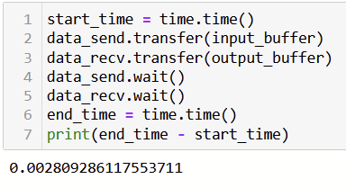
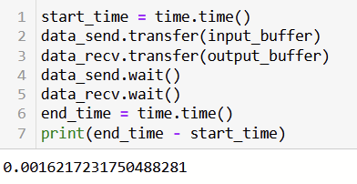
Acceleration on board
Numpy time
PS time with for loops
Unoptimized PL time
Optimized PL time
Acceleration factor(Unopt) = 70.43
Acceleration factor(Opt) = 123.69

Slide 11


RMSE on board
Unoptimized
Optimized

Slide 12
100x100

Slide 13
RMSE on Vitis
Unoptimized 3.2e-5
Optimized 3.2e-5

Slide 14
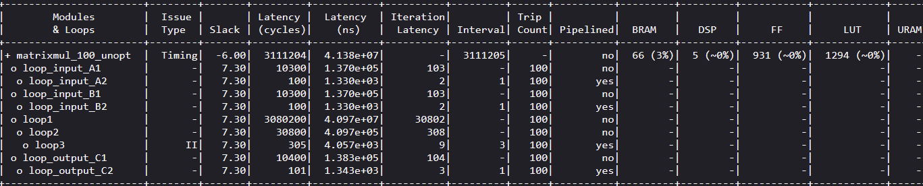
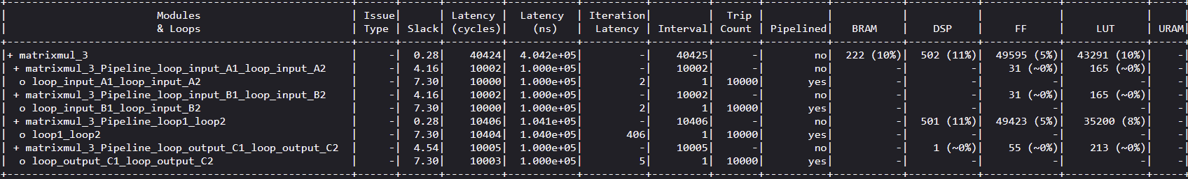
Latency & Resources in Vitis Synthesis Report
Unoptimized
Optimized

Slide 15
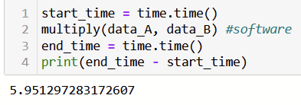
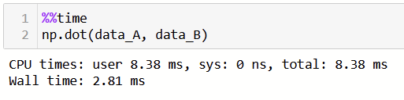
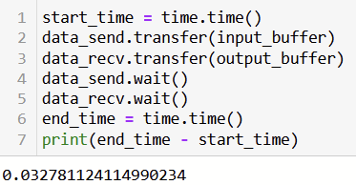
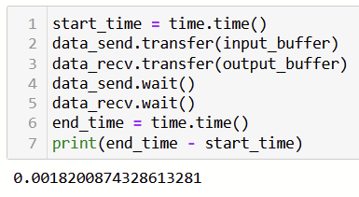
Acceleration on board
Numpy time
PS time with for loops
Unoptimized PL time
Optimized PL time
Acceleration factor(Unopt) = 181.44
Acceleration factor(Opt) = 3269.23
Optimized PL beats numpy!!

Slide 16


RMSE on board
Unoptimized
Optimized

Slide 17
100x100 with
Word Length
Optimization

Slide 18

Latency & Resources in Vitis Synthesis Report
Float
Fixed <29,9>

Slide 19
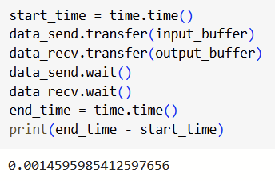
Acceleration on board
Numpy time
PS time with for loops
Optimized PL time
Acceleration factor = 4079.03
Optimized PL beats numpy!!

Slide 20



RMSE on board
Float
Fixed point <29,9>
Fixed point <23,11>
Lesser precision= More error!

Slide 21
Summary
S.no. | Size | Acc Factor | RMSE on board
1 | 8x8 unopt | 1.11 | 1.1e-6
2 | 8x8 opt | 2.33 | 8.5e-7
3 | 32x32 unopt | 70.43 | 6.18e-6
4 | 32x32 opt | 123.69 | 5.58e-6
5 | 100x100 unopt | 181.44 | 3.16e-5
6 | 100x100 opt_float | 3269.23 | 2.84e-5
7 | 100x100 opt + WLO | 4079.03 | 1.7e-4

Slide 22


Thank you!!

